Slide 1
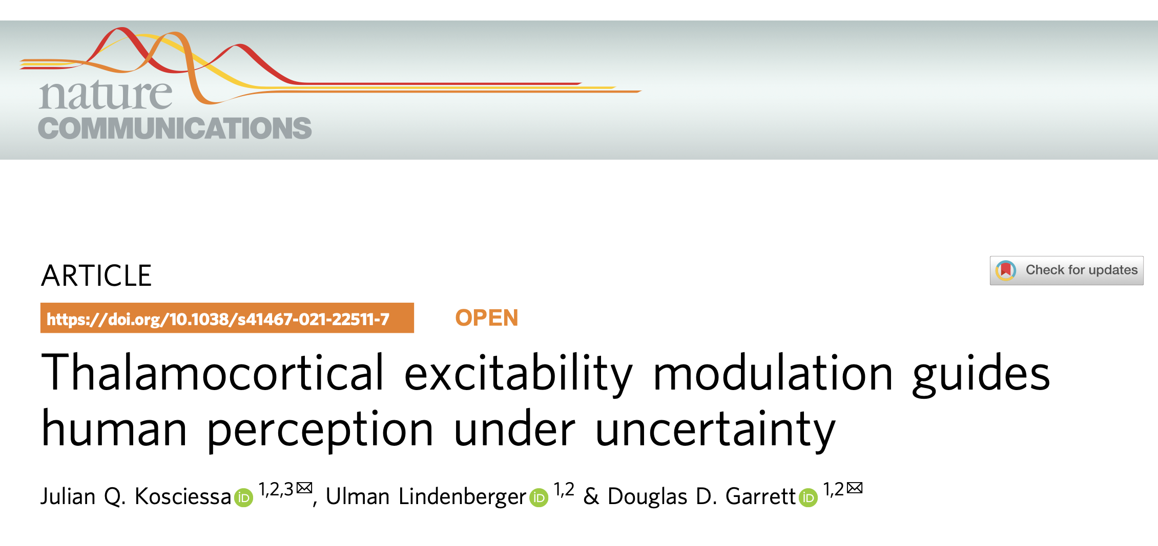
丘脑皮质兴奋性调节指导不确定性下的人类感知

Slide 2
Core Question
大脑如何应对“未知”？
低不确定性：目标明确
OR
高不确定性：目标模糊
大脑的处理‘模式’如何切换？
——Thalamocortical excitability modulation guides human perception under uncertainty——

Slide 3
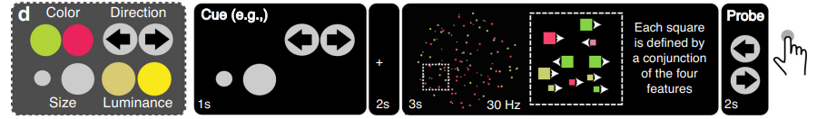
The Experimental Task: MAAT
如何量化“不确定性”？
MAAT任务
Cue
Stimulus
Probe
——Thalamocortical excitability modulation guides human perception under uncertainty——

Slide 4
Data
多模态证据
EEG
fMRI
Pupil
Behavior
——Thalamocortical excitability modulation guides human perception under uncertainty——

Slide 5
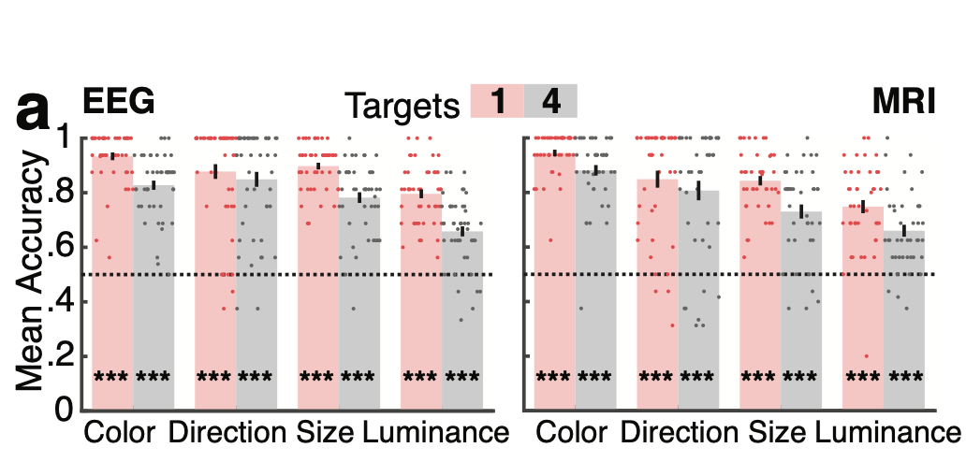
Key Behavioral Findings
Accuracy
所有特征在群体水平上的平均准确率均显著高于随机水平（0.5）

Slide 6
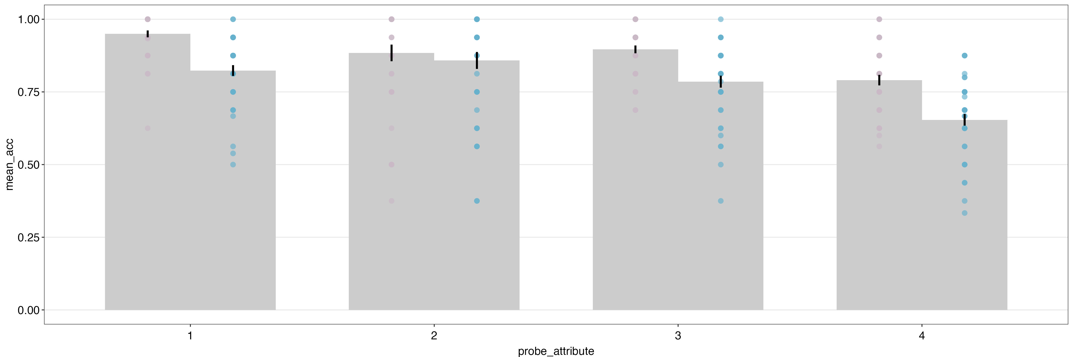
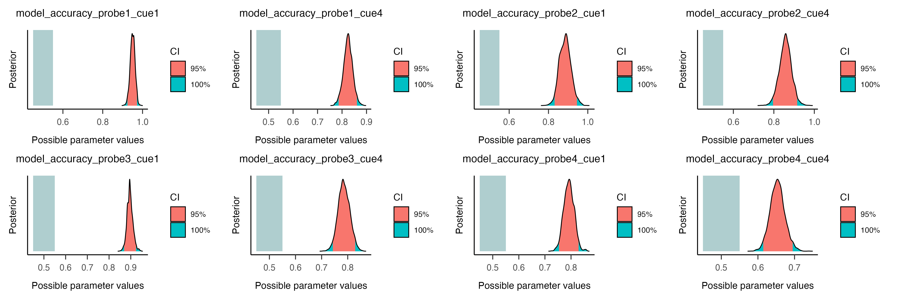
Our Replicated Results

Slide 7
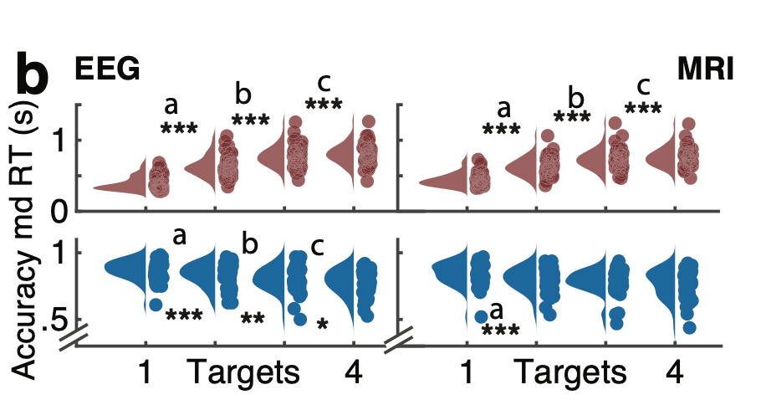
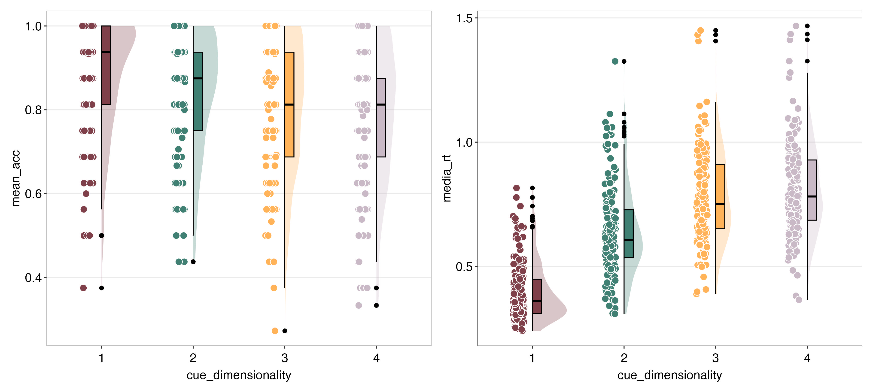
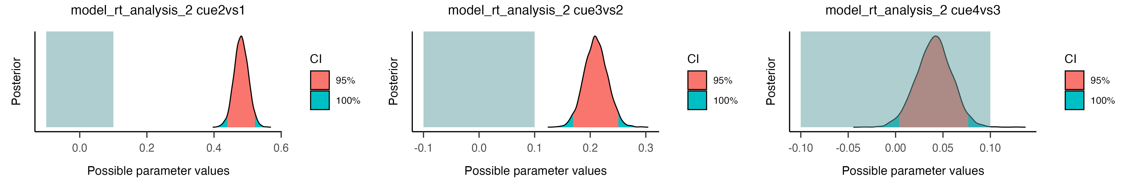
随着目标数量增加，反应时显著增加，准确率显著下降。

Slide 8
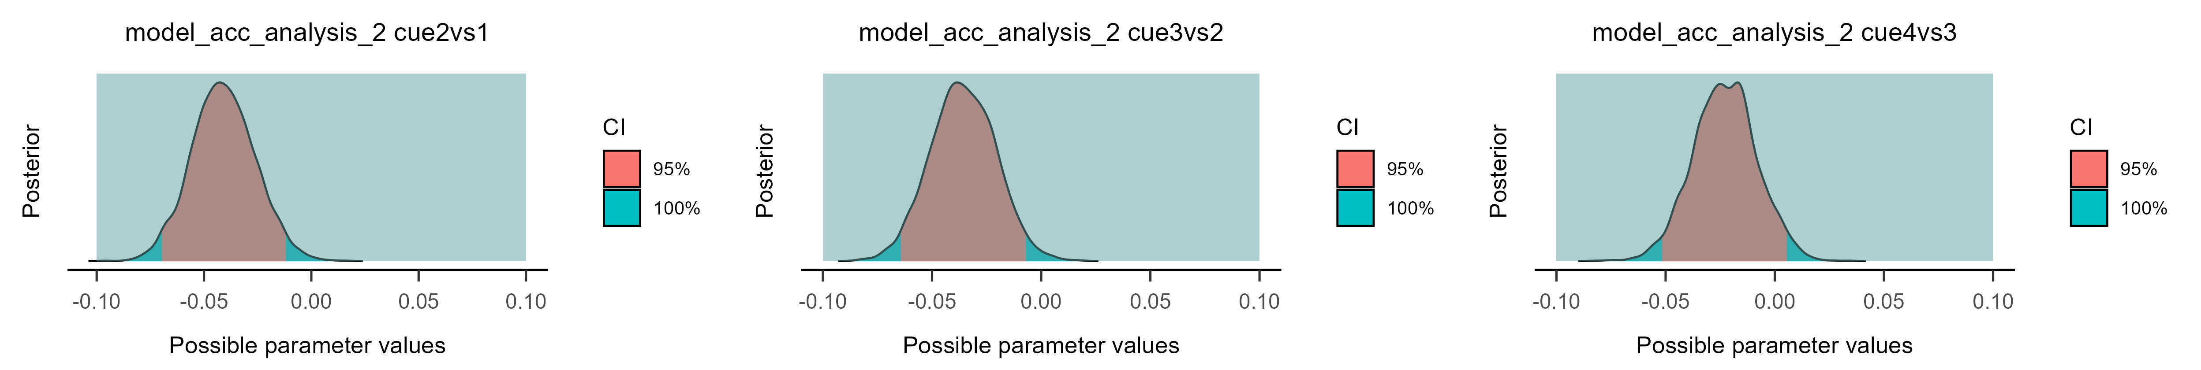
随着目标数量增加，反应时显著增加，准确率显著下降。

Slide 9
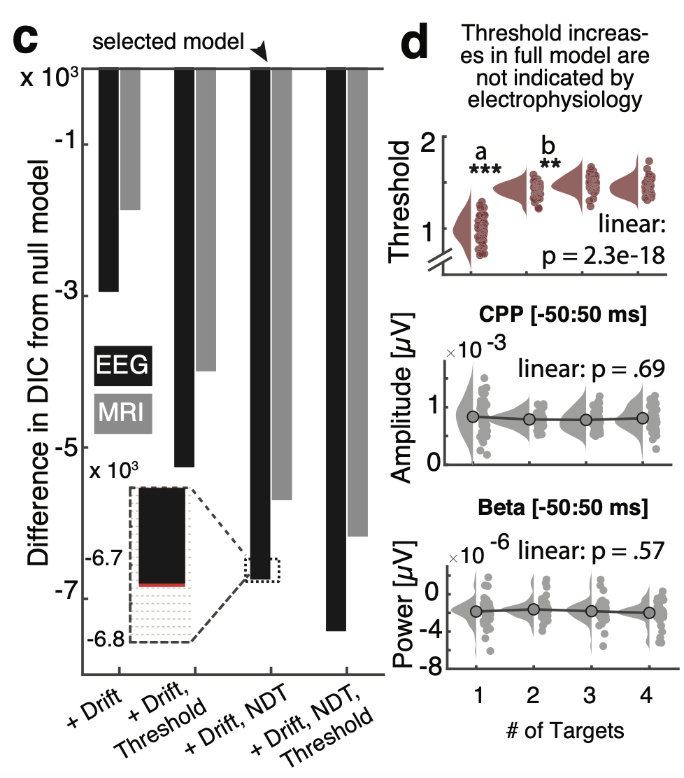
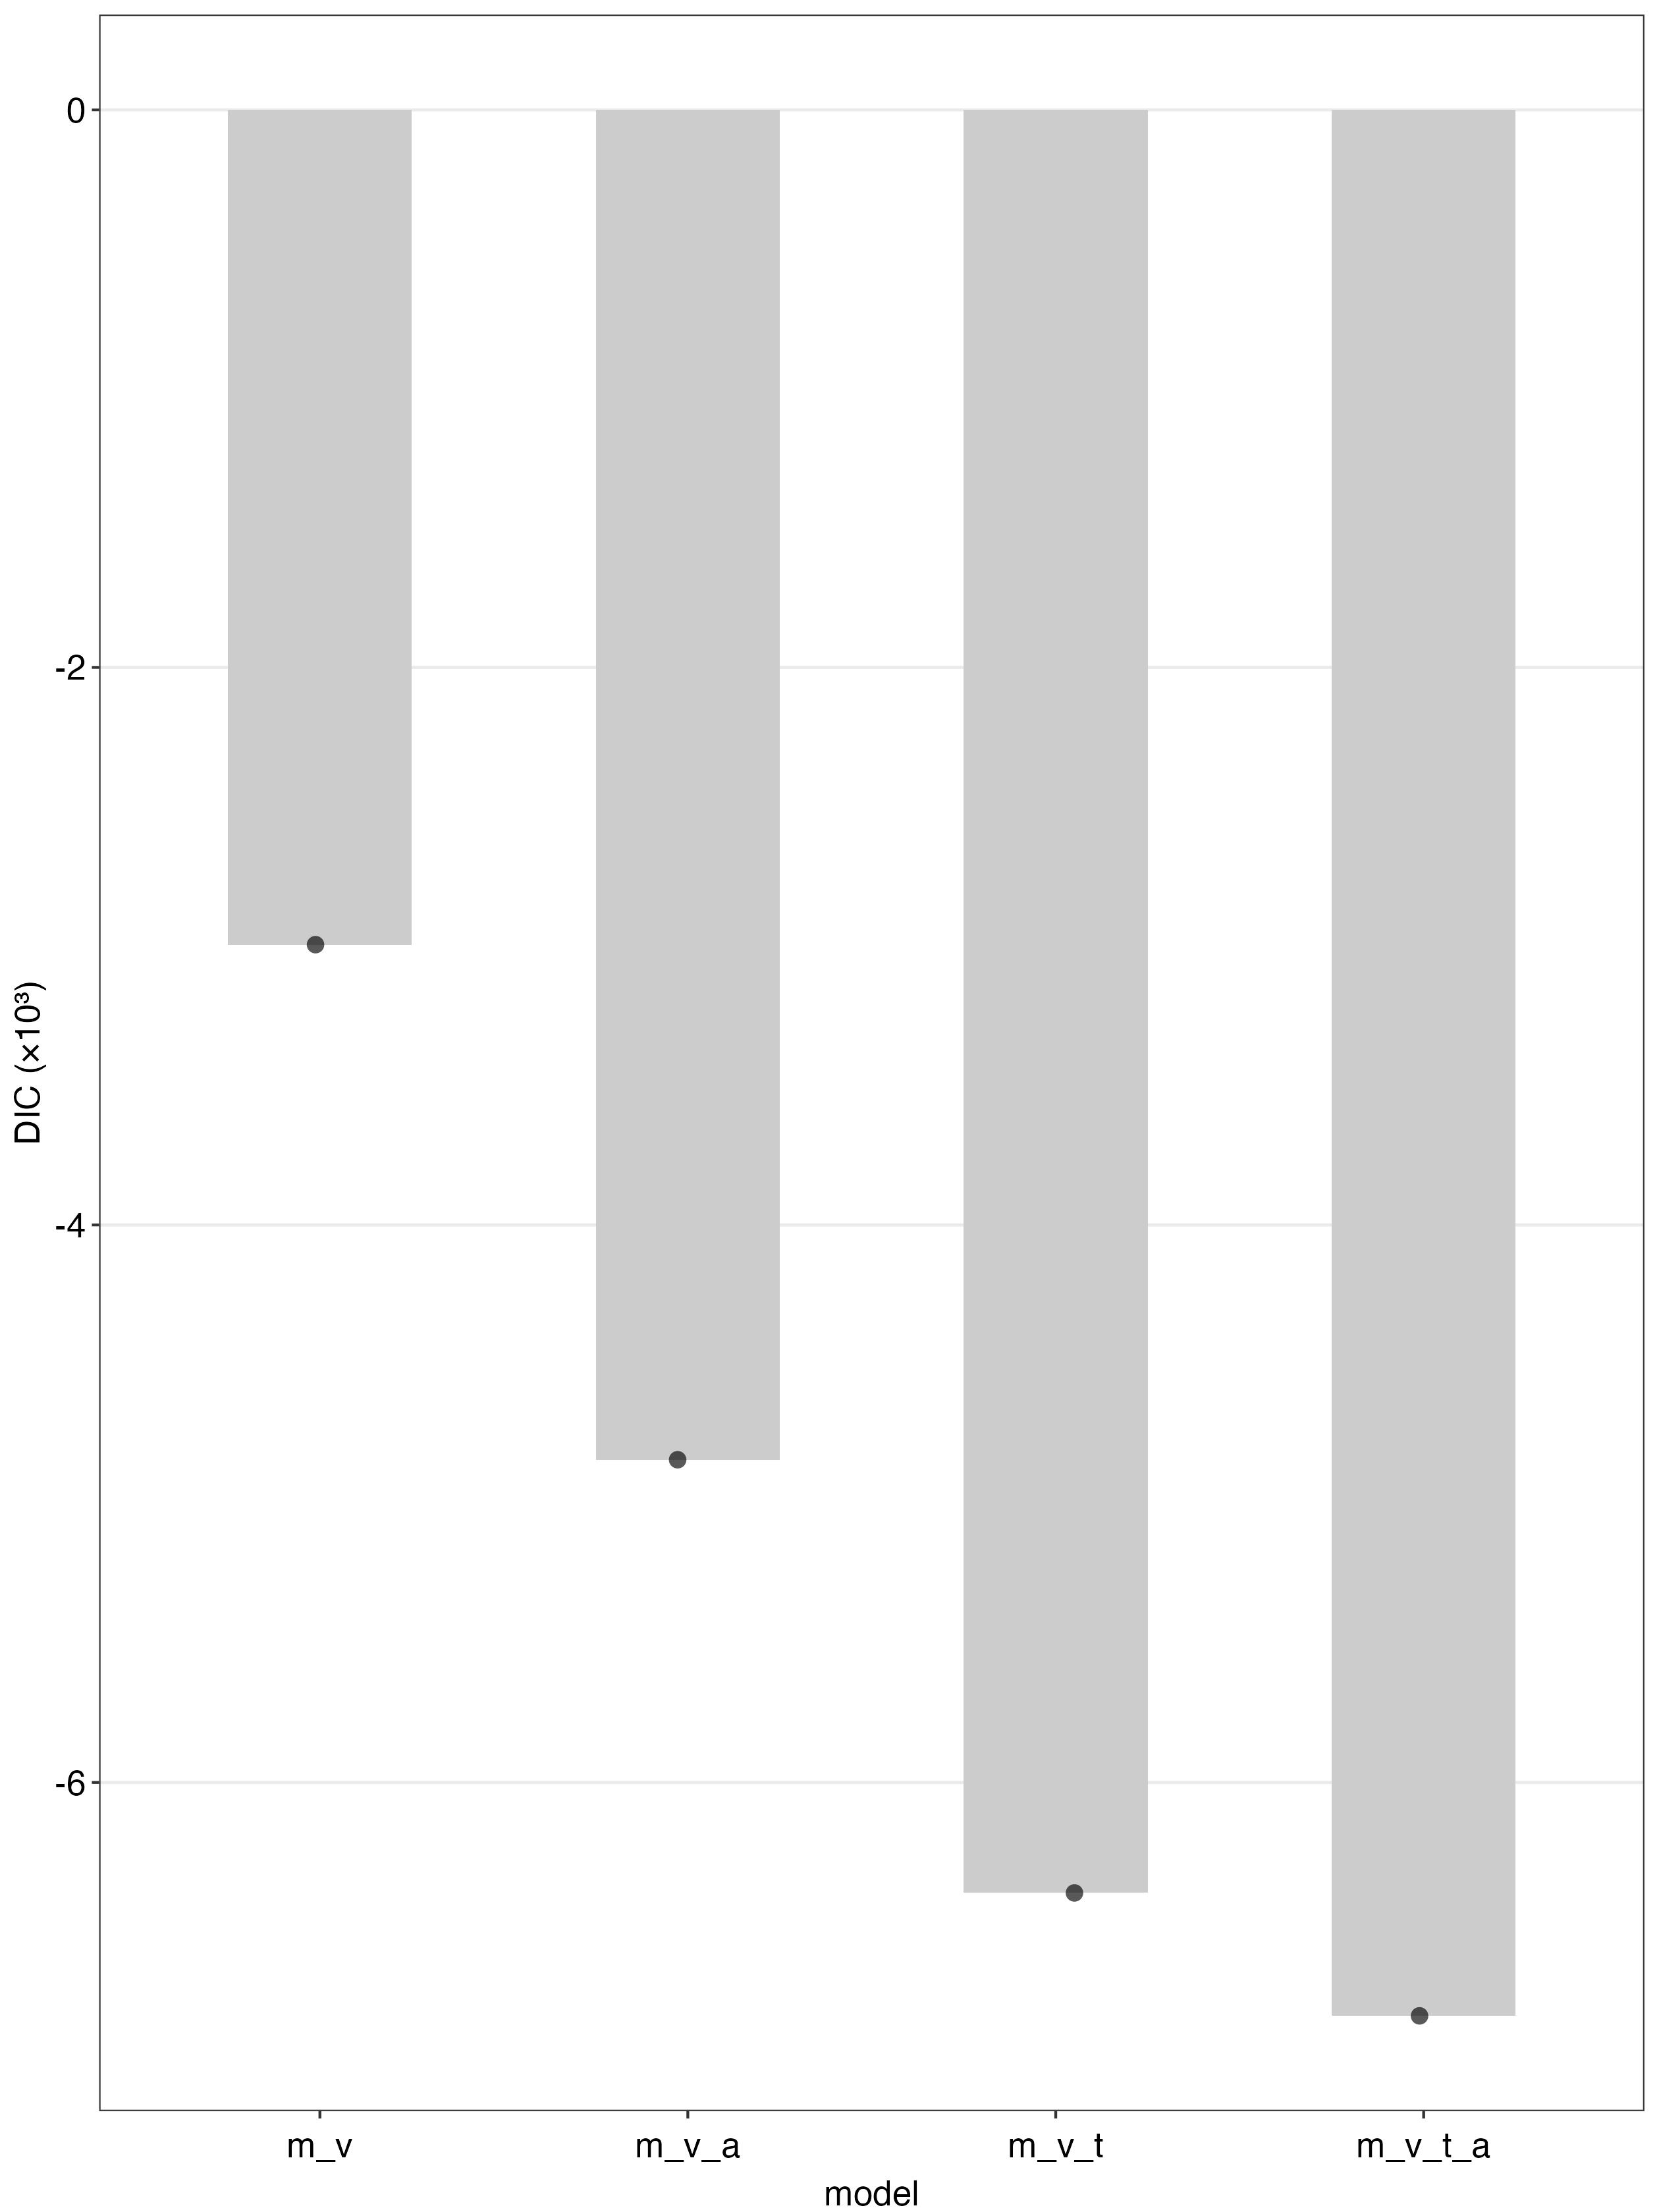

Slide 10
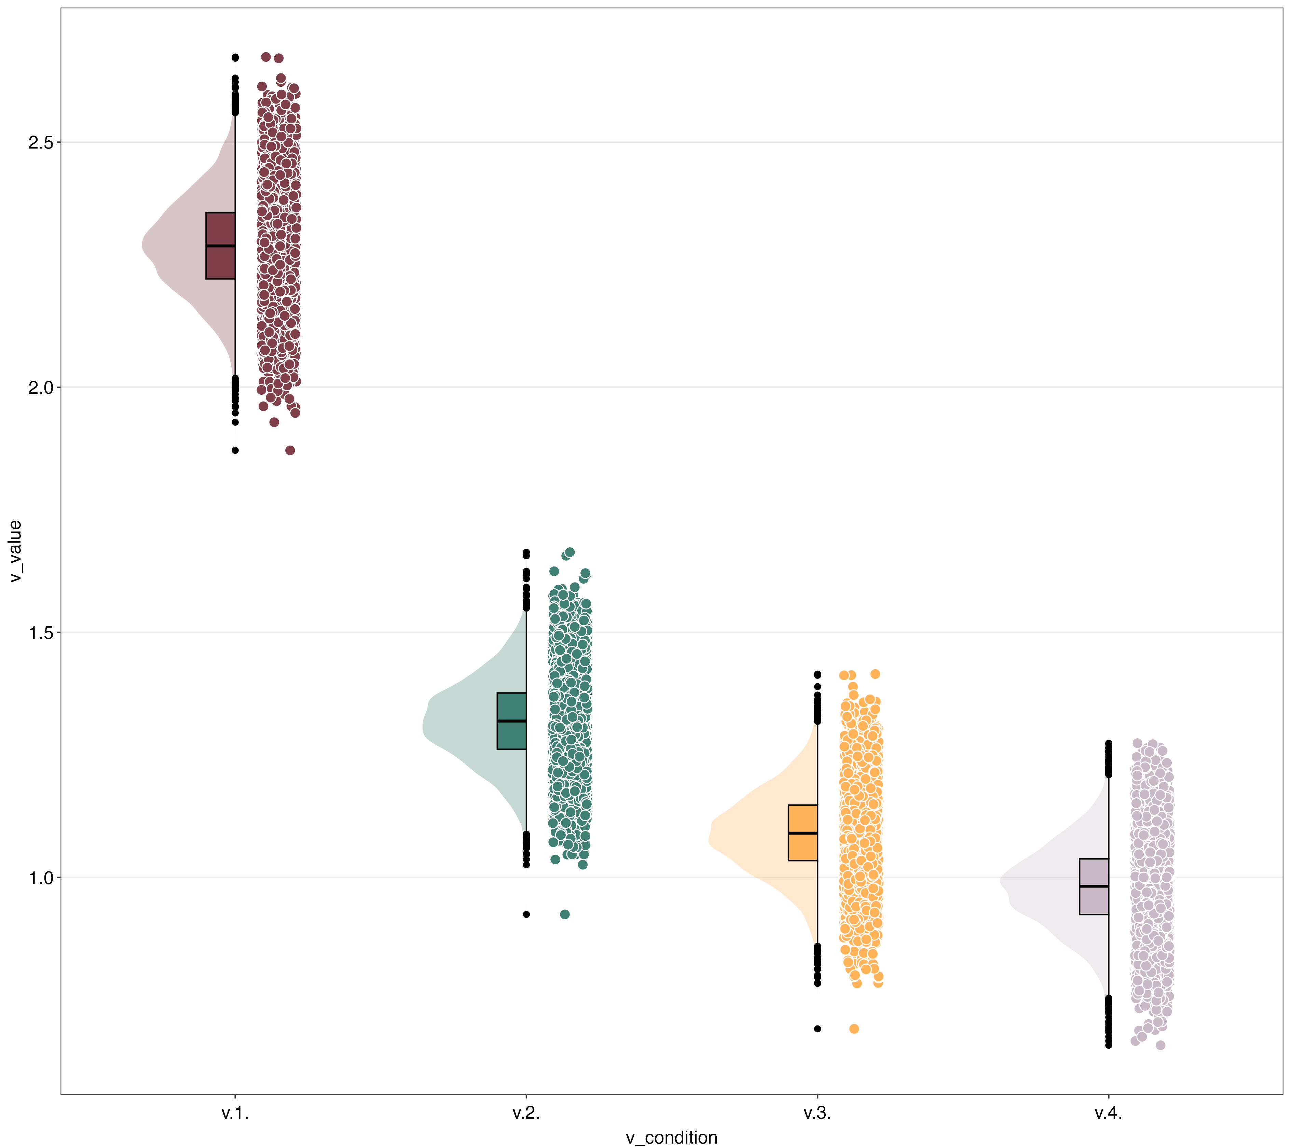
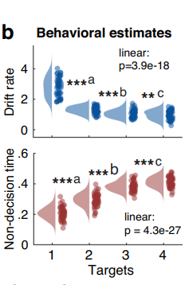
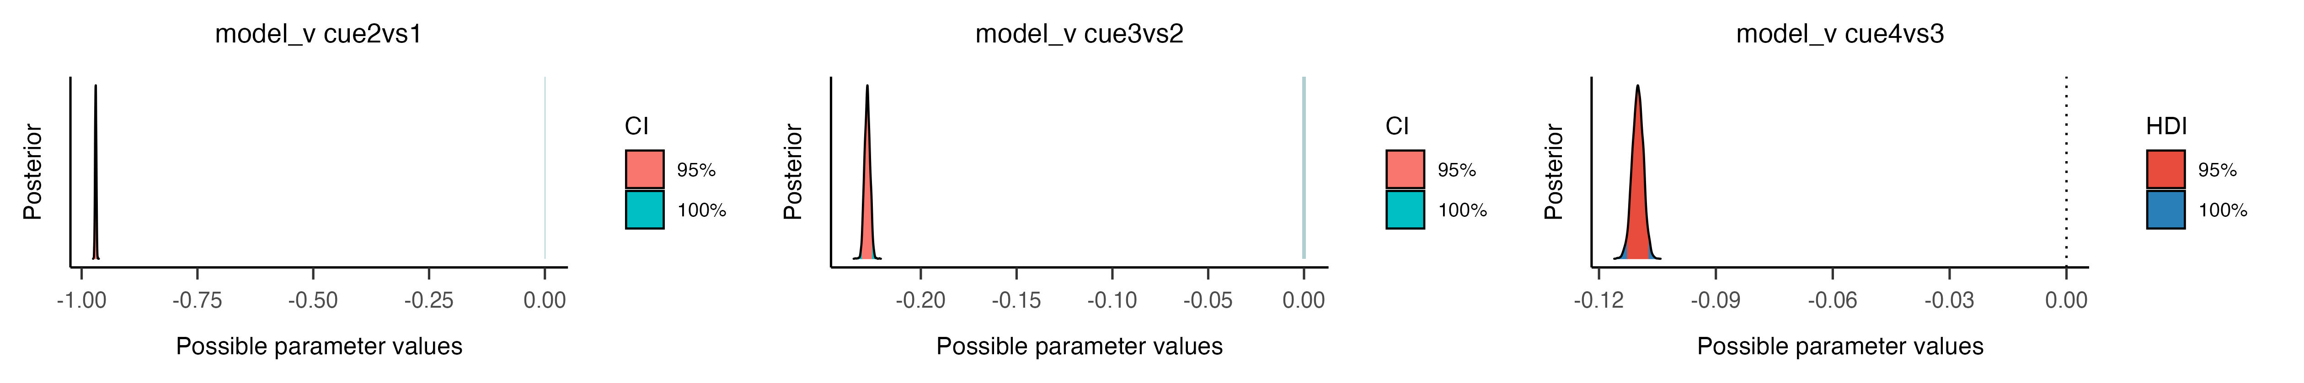
Our Replicated Results

Slide 11
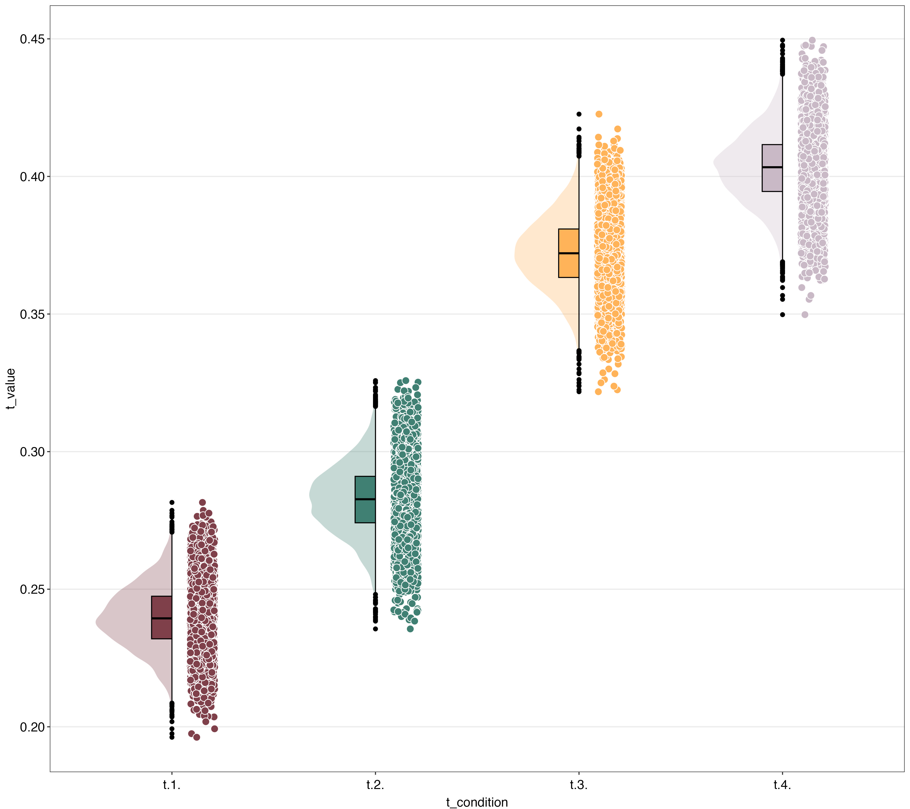
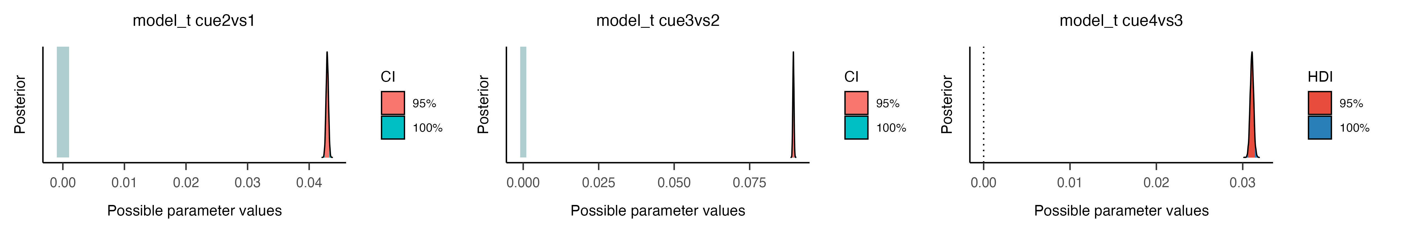
Our Replicated Results

Slide 12
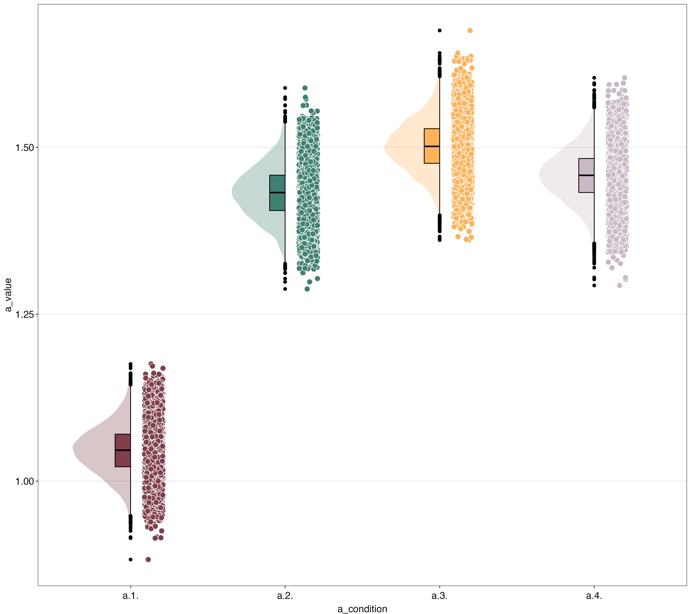
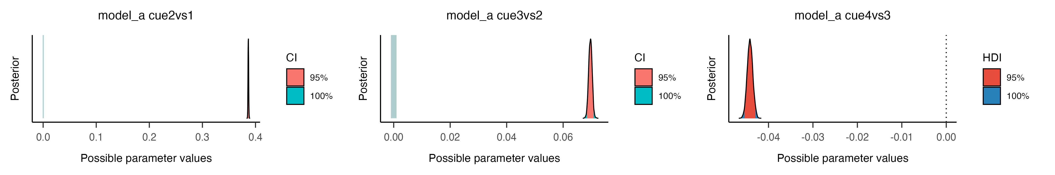
Our Replicated Results

Slide 13
Our Replicated Results
code
——Thalamocortical excitability modulation guides human perception under uncertainty——

Slide 14
Thanks！
汇报人：任子伟
PPT制作：李昕彦 任子伟
代码：黄逸杰
文字材料：范赵丽 王雅情

Slide 15
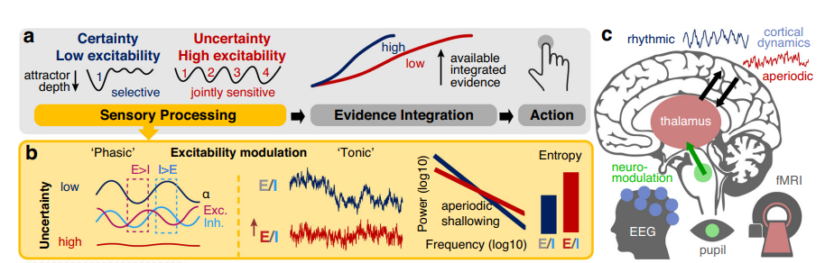
The Core Hypotheses
从“节律性门控”到“紧张性兴奋”
——Thalamocortical excitability modulation guides human perception under uncertainty——

Slide 16
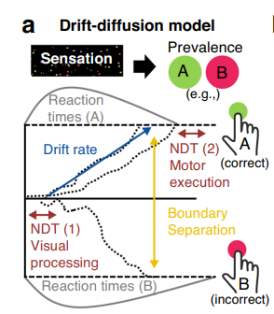
Key Behavioral Findings
漂移扩散模型
漂移率
决策阈值
非决策时间
——Thalamocortical excitability modulation guides human perception under uncertainty——

Slide 17
Key Behavioral Findings
完整HDDM表明边界分离随目标数量增加而增加
CPP：证据积累的神经标志，未显示阈值差异
对侧β功率：运动准备指标，也未显示阈值差异
行为模型预测的阈值增加未被神经证据支持
选择了更简约的行为模型

Slide 18
Our Replicated Results
# Analysis 1: compare accuracy with chance level between 1and 4 distributions in each single feature
# 1. Select 1 and 4 in column of 'cue_dimensionality'
# 2. Use brms to calculate the difference of accuracy
# 3. Models diagnosis
# 4. Statistic inference
# 5. plot
# Analysis 2: Compare ACC and RT between different distributions
# 1. Set and sample Bayesian models for ACC and RT
# 2. Models diagnosis
# 3. Statistic inference
# 4. plot
——Thalamocortical excitability modulation guides human perception under uncertainty——

Slide 19
Key Behavioral Findings
RT
&
Accuracy
随着目标数量增加，反应时显著增加，准确率显著下降。

Slide 20
Key Behavioral Findings
目标数量↑ 反应时↑
正确率↓ 漂移率↓
——Thalamocortical excitability modulation guides human perception under uncertainty——

